Slide 1


IN-MEMORY NOSQL, Now OPEN SOURCE!
ACID & CAP:
Clearing CAP Confusion and Why C In CAP ≠ C in ACID
Srini V. Srinivasan, Ph.D
Sunil SayYaparajU
Aerospike aer . o . spike [air-oh- spahyk] noun, 1. tip of a rocket that enhances speed and stability

Slide 2

REQUIREMENTS FOR INTERNET ENTERPRISES
Notes:
Know who the Interaction is with - > Monitor 200+ Million US Consumers, 5+ Billion mobile devices and sensors
Determine intent based on current context -> Page views, search terms, game state, last purchase, friends list, ads served, location
Respond now, use big data for more accurate decisions -> Display the most relevant Ad -> Recommend the best product - > Deliver the richest gaming experience -> Eliminate fraud…
Service can NEVER go down!

Slide 3
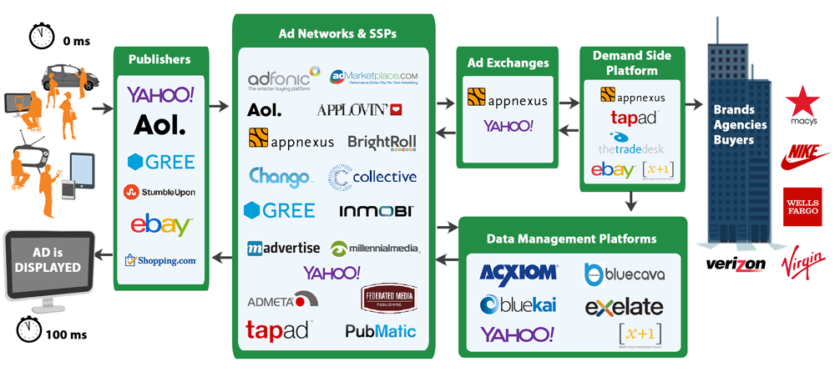
Introduction to Advertising: Real-time Bidding
Notes:
Let’s start with what happened in internet advertising that kicked off a scale revolution.
In 2000, Google launched AdWords. This was the ability to buy advertising on a search keyword, instead of a web page.
Display advertising was still static. Prior to 2005, internet advertising was traded statically. A person bought a certain number of impressions on a website – like buying 1M impressions on the Yahoo home page. These were “rotated” using a variety of technologies, but the model fit the existing model of media buying. Advertising companies would say “you want an article in Car and Driver? And on Car and Driver’s website?”
In April 2007, Yahoo bought RightMedia. March 2008, Google acquired DoubleClick. Both of these systems matching display advertisements with consumers, based on “cost per click”, and revolutionized the industry.
Google’s position in the center of advertising, as a black box, was challenged by open bidding exchanges. Founders of both RightMedia and DoubleClick created several companies, and an open “auction system” to democratize the flow of impressions (from publishers) and ads (from advertisers). These companies realized that real time pricing – individual auctions – were the only fair system for determining price.
The RTB system has been used to monitize “long tail” (remenant) advertising, which catches users wherever they might go. “Premium” advertising is still in high demand, and may or may not enter the real-time bidding system.
At the time of Facebook’s public launch, they used the same closed system that Google Search uses. They eventually found they didn’t have enough advertising content, income was down, thus they opened facebook exchange.
At the time, many technologists said about advertising: the algorithms are simple, it’s only scaling that’s hard. Exchanges that slowed down publisher websites were quickly avoided.
The 150 millisecond rule was established, with advertising platforms needing to deliver ads in 150ms to an end user. Platform companies realized the critical nature of keeping that contract – if they failed, there would be fewer ads per page, and less revenue to be had. Although some might argue that there is too much display advertising today, this exchange capacity has become necessary for satisfying mobile.

Slide 4
North American RTB speeds & feeds
1 to 6 billion cookies tracked
Some companies track 200M, some track 20B
Each bidder has their own data pool
Data is your weapon
Recent searches, behavior, IP addresses
Audience clusters (K-cluster, K-means) from offline Hadoop
“Remnant” from Google, Yahoo is about 0.6 million / sec
Facebook exchange: about 0.6 million / sec
“other” is 0.5 million / sec
Currently about 3.0M / sec in North American

Slide 5
Advertising requirements
100 millisecond or 150 millisecond ad delivery
De-facto standard set in 2004 by Washington Post and others
North America is 70 to 90 milliseconds wide
Two or three data centers
Auction is limited to 30 milliseconds
Typically closes in 5 milliseconds
Winners have more data, better models – in 5 milliseconds

Slide 6
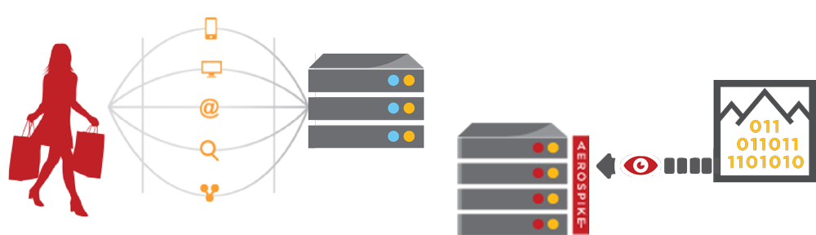



Advertising Technology Stack
APP SERVERS
WRITE CONTEXT
DATA
WAREHOUSE
INSIGHTS
BATCH ANALYTICS
Discover patterns, segment data: location patterns, audience affinity
MILLIONS OF CONSUMERS
BILLIONS OF DEVICES
OPERATIONAL DB
WRITE REAL-TIME CONTEXT
READ RECENT CONTENT
PROFILE STORE
Cookies, email, deviceID, IP address, location, segments, clicks, likes, tweets, search terms...
REAL-TIME ANALYTICS
Best sellers, top scores, trending tweets
Notes:
This is the technology stack that major advertising technology companies built
To sustain the crushing load of aggregating the clicks and views from so many websites
Individual retailers are now using this same tech stack, for the same reason
They wish to present an experience, and include Analytics-based results

Slide 7



Financial Services – Intraday Positions
Finance App
Records App
ACCOUNT
POSITIONS
RT Reporting App
REAL-TIME
DATA FEED
Query
Read/Write
XDR
Start of Day
Data Loading
End of Day
Reconciliation
10M+ user records
Primary key access
1M+ TPS planned
LEGACY DATABASE
(MAINFRAME)
Notes:
Advertising was one of the pioneers, now other enterprises are understanding the need
For this architecture.
The traditional software & hardware providers scoff at these requirements and speed, but
Cutting edge companies now understand that the technology is available, and are finding uses
In their interprises.
We are working with several financial services companies on providing an Intraday Positions
Database. Instead of a cache / relational architecture, the requirement is around 1M TPS
Velocity driven by:
Faster trading
Mobile customers
Recommendations

Slide 8



Social Media
Java application tier
Data abstraction and sharding
Recent user generated content
Content and
Historical data
MODIFIED REDIS
(SSD ENABLED)
MYSQL or POSTGRES
(ROTATIONAL DISK)
Notes:
In China, Weibo, Alibaba, and TenCent are masters of agility, jumping on new trends in application design, at scale. A recent discussion with Pinterest showed a similar design.
These companies see the benefits of the flexibility of in-memory NoSQL on the front application tier, but also abstract the application logic from database choice and scale using a separate layer.
They also use this layer to separate users into “high traffic” and “low traffic”, and to allow different optimization patterns. An engineer at Weibo told me this was the most important optimization. Instead of allowing developers to directly access a database – making assumptions about that database’s performance and indexes – it is better to create an APPLICATION SPECIFIC – with DOMAIN KNOWLEDGE – layer.

Slide 9




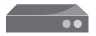









Modern Scale Out Architecture
CONTENT
DELIVERY NETWORK
LOAD BALANCER
Load balancer
Simple stateless
APP SERVERS
RESEARCH
WAREHOUSE
Fast stateless
Long term cold storage
IN-MEMORY NoSQL
HDFS BASED
Notes:
Here are the technologies and technology providers to watch in each area.
Go through the App Layer in particular
Research warehouse --- includes new systems like Spark
--- easy to have multiple analytics systems, common in large deployments
--- HDFS based systems

Slide 10
ACID
A : Atomicity
All the changes will happen or none of them will happen
Aborted transactions are rolled back
C : Consistency
Database will adhere to all the consistency rules before and after every transaction
I.E, Data integrity is preserved before and after transaction
Consistency rules specified by constraints for check, foreign keys, etc.
I : Isolation
Defines what data will be shown to the transactions
Level-0/1/2/3 : Different types of locking semantics are used
D : Durability
Committed changes will never be lost
Usually achieved by writing both log & data

Slide 11
CAP
C : Consistency
All the copies of the data are same in a distributed system with replication
A : Availability
The system is 100% responsive for reads and writes with strict SLA
It could return failure temporarily for a finite amount of time
P : Partition Tolerance
System continues to work (take reads/writes) even if some nodes cannot talk to each other
Brewer’s CAP THEOREM
Only two of the three (C, A, P) can be satisfied in any distributed system
COROLLARY
A system has to choose one of C or A in the event of partitioning

Slide 12
C for Controversy
C in ACID != C in CAP
So, ACID is possible in distributed systems
ACID
C A P

Slide 13
ACID in Aerospike
Atomicity
Currently, single-record atomicity with replication and secondary indexes
Entire object including all the bins are changed together. “Copy on write”
If any portion of the update fails, the entire operation is aborted
Consistency
No RDBMS style constraints can be defined
Implied constraints are enforced, for example:
Secondary index queries need to be able to find objects after the write transaction completes.
Isolation
Supports read-committed isolation for long transactions like backup/restore, scans, etc. (level-1)
Provides Check-And-Set (CAS) operations
Durability
Achieved by writing to multiple replicas synchronously
E.g., if one node fails, other copies can be used
Effectively the level of durability is the same as using disk + log in traditional systems
Enhanced durability
Rackaware replication
Backup + Restore
XDR : Cross Datacenter Replication

Slide 14
CAP in Aerospike
Consistency
Immediate consistency : All replicas are updated synchronously
Availability
New master/replicas will be assigned immediately on cluster state change
New master will start taking writes
Old replicas will server the reads
Partition-tolerance
Tries to avoid partitioning (secondary heartbeats)
Chooses Availability over consistency
Achieves eventual consistency when network restores
For internet applications (e.g., Real-time Bidding in Display advertising)
(AP + Eventual consistency) could be better than (CP - Availability)
For enterprise applications (e.g., Consumer access to Retail Banking Accounts)
C is paramount + A is very important, so partitions need to be avoided like the plague

Slide 15
Partitions are Rare
Brewer’s CAP Revisited – 2012
“First, because partitions are rare, there is little reason to forfeit C or A when the system is not partitioned.”
Fast heartbeats
Nodes close to each other in same data center and same switch/rack
Dual channel replicated heartbeats keeps system robust during network switch failures
Ensures fast cluster formation and reorganization using Paxos algorithm
Handling consistency during node failures
Generation count based conflict detection and resolution
Duplicate resolution for reads during cluster reorganization
Atomically moving data partitions from one cluster node to another

Slide 16

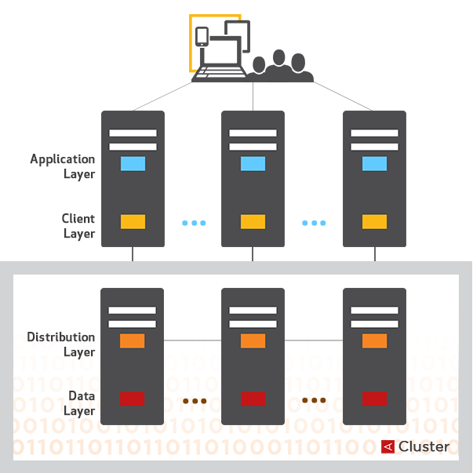
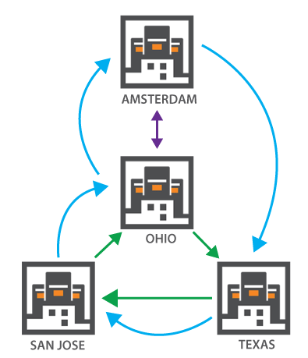
SHARED-NOTHING SYSTEM:100% DATA AVAILABILITY
Every node in a cluster is identical, handles both transactions and long running tasks
Data is replicated synchronously with immediate consistency within the cluster
Data is replicated asynchronously across data centers
OHIO Data Center

Slide 17
Consistency and Availability Tradeoffs
Brewer’s CAP Revisited – 2012
"Second, the choice between C and A can occur many times within the same system at very fine granularity; not only can subsystems make different choices, but the choice can change according to the operation or even the specific data or user involved."
Data path tradeoff during partition migration
Providing repeatable read results in higher read latency when multiple copies of data partitions are being merged
Disabling repeatable read could deliver slightly stale data during partition migrations
Cluster state tradeoff during cluster formation event
Individual cluster nodes can reject requests for brief periods (10 milliseconds) to ensure that a new cluster forms in a timely manner
Clients barely notice this and cluster reorganization events are rare

Slide 18



WRITING RELIABILY WITH HIGH PERFORMANCE
master
replica
Writing with Immediate Consistency
Adding a Node
transactions
continue
Write sent to row master
Latch against simultaneous writes
Apply write to master memory and replica memory synchronously
Queue operations to disk
Signal completed transaction (optional storage commit wait)
Master applies conflict resolution policy (rollback/ rollforward)
Cluster discovers new node via gossip protocol
Paxos vote determines new data organization
Partition migrations scheduled
When a partition migration starts, write journal starts on destination
Partition moves atomically
Journal is applied and source data deleted

Slide 19
Tuning and High Performance
Brewer’s CAP Revisited – 2012
"Finally, all three properties are more continuous than binary. Availability is obviously continuous from 0 to 100 percent, but there are also many levels of consistency, and even partitions have nuances, including disagreement within the system about whether a partition exists."
Tunable system
Repeatable read allows higher consistency while lowering availability
Heartbeat tuning helps system to continue to work in a robust manner
Increasing replication factor to more than 2 helps keep small highly used data consistent
Write all copies (sync and default) versus respond on master-complete (async)
High Performance
Vertical scale at 1M TPS / 10 TB node results in smaller clusters
Smaller clusters leads to more robust system enabling 100% uptime
Fast restart of servers (in seconds) minimizes the time when nodes go out of sync

Slide 20
Partition Avoidance versus Partition Detection
Brewer’s CAP Revisited – 2012
"Because partitions are rare, CAP should allow perfect C and A most of the time, but when partitions are present or perceived, a strategy that detects partitions and explicitly accounts for them is in order. This strategy should have three steps: detect partitions, enter an explicit partition mode that can limit some operations, and initiate a recovery process to restore consistency and compensate for mistakes made during a partition."
High Consistency in AP Mode
Avoid, as much as possible, the need to sacrifice consistency by minimizing formation of network partitions
High consistency using robust heartbeats, block for a few milliseconds during cluster formation, etc.
Tunable consistency using repeatable read setting to maintain or relax consistency as necessary
Smaller high capacity clusters hugely improves system behavior
High Availability in CP Mode
Static cluster to pre-define cluster size
Detect partition occurrence accurately and enforce appropriate policies to protect the data
Suspend partition migrations when the cluster is not whole
Some amount of availability needs to be sacrificed to maintain consistency
Block writes to partitions all of whose copies are not available in the partitioned cluster
Serve reads if the replica is alive
Not all reads/writes will fail, Only, writes meant for the nodes which are down will fail

Slide 21
Conclusion
Brewer’s CAP Revisited – 2012
http://www.infoq.com/articles/cap-twelve-years-later-how-the-rules-have-changed
Aerospike has been in development for about 6 years
Does not sacrifice consistency at the altar of availability and high performance
Has independently discovered and exploited some of the flexibility available to distributed systems as expressed in Brewer’s 2012 article
Attempts to provide the highest consistency, highest availability and highest performance possible in a distributed system
Aerospike is now Open Source
https://github.com/aerospike/aerospike-server
Download and check it out!

